Slide 1
Unit 2 :
Logical Database Design
Databases
1

Slide 2
UNIT 2: LOGICAL DESIGN OF DATABASES
Data model
The representation of the problem: E/R diagrams
2.1 Entities
2.2 Attributes and types
2.3 Relationships
2.4 Cardinality
2.5 Weakness
The expanded E/R model.
Construction of an E/R diagram
The relational model
5.1 Characteristics of a relationship.
5.2 Restrictions
5.3 Primary keys and foreign keys
5.4 Referential Integrity
5.5 Representation of the relational schema
5.6 Step from the E/R diagram to the relational model.
Standardization.
6.1 Functional dependencies
6.2 Normal forms
2

Slide 3

6- Normalization
Standardization
Process that seeks to guarantee that a series of standards are met.
First of all, it must be guaranteed that there is no redundancy in the saved data.
Secondly, coherence is sought in the conceptual scheme of the stored data.
We will transform the original complex structures into small, simpler and more stable data.
The aim is to avoid logical errors derived from a complex structure.
A normalized database will take up less space than a non-normalized one.
There are several Normal Forms, each one derived from the previous one. Before discussing normal forms, let's look at the concept of functional dependency between attributes or groups of attributes.
3

Slide 4
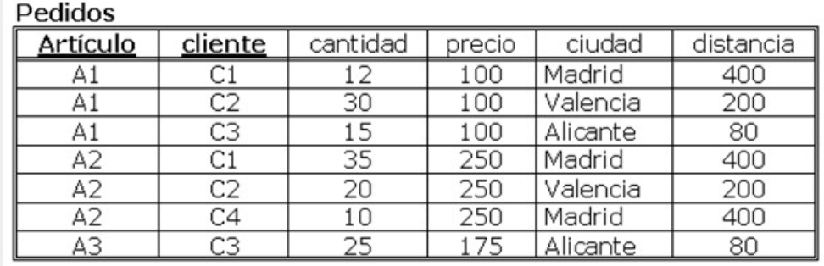
6- Normalization
Improper Design:
This design is inappropriate because:
There is redundancy : price, city, distance are repeated unnecessarily.
Modification anomalies : By mistake we could have the same item with two prices.
Insertion anomalies : When inserting a new item we can make errors since we are actually placing an order, not an item.
Deletion anomalies : If we delete, for example, orders A1-C2 and A2-C2, we lose the data of customer C2.
4

Slide 5
6.1.- Functional dependency
Concept of functional dependence:
It is said that, in a table or relationship, an attribute depends functionally from another attribute if each value of X is associated in all moment to a single value of Y. We also say that X is implicant of Y.
Compllete functional dependence :
Given a combination of attributes (X1,X2,...), it is said that Y has complete functional dependence of those attributes if it depends functionally of that set but it doesn't depend functionally from a subset of them .
Transitive functional dependence:
a functional dependence is transitive if it holds that “a implies b” and “b implies c” and it does not hold that “b implies a” .
5

Slide 6
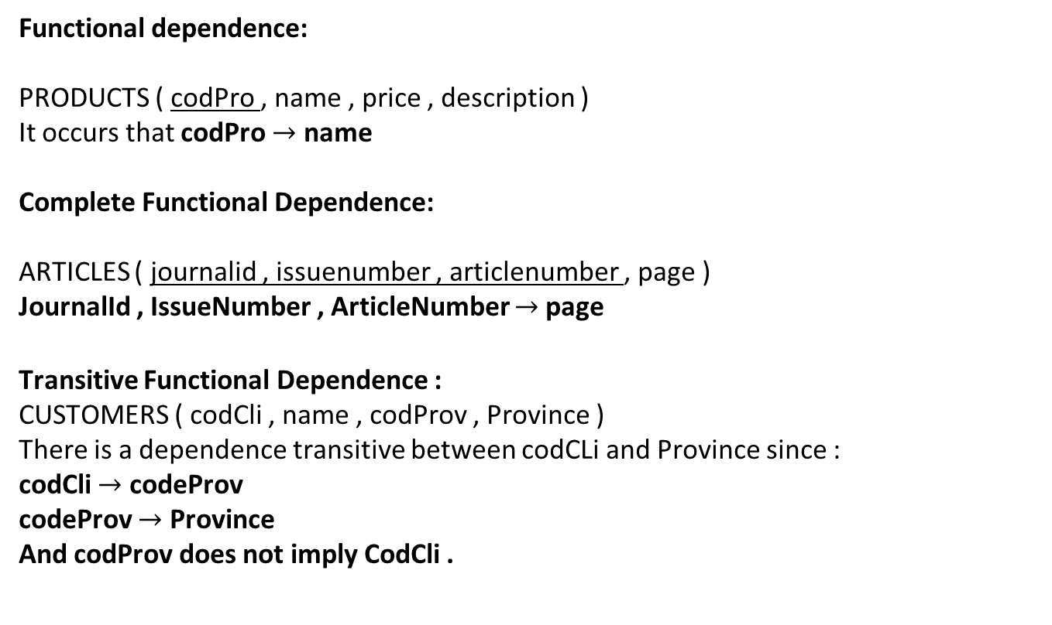
6.1.- Functional dependency
Functional dependence:
PRODUCTS ( codPro , name , price , description )
It occurs that codPro $→$ name
Complete Functional Dependence:
ARTICLES ( journalid , issuenumber , articlenumber , page )
JournalId , IssueNumber , ArticleNumber $→$page
Transitive Functional Dependence :
CUSTOMERS ( codCli , name , codProv , Province )
There is a dependence transitive between codCLi and Province since :
codCli $→$ codeProv
codeProv $→$ Province
And codProv does not imply CodCli .
6

Slide 7
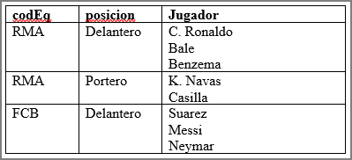
6.2.- Normal Forms
FN1:
This normal form prohibits attributes in a table that can take multiple values. It is a form inherent to the model since the tables of a relational DBMS prevent it from being carried out.
This table is not in FN1. The solution will be:
codeEq | position | Player
RMA | Forward | C. Ronaldo
RMA | Forward | bale
RMA | Forward | Benzema
RMA | Goalie | K. Navas
RMA | Goalie | Box
FCB | Forward | Suarez
FCB | Forward | Messi
FCB | Forward | Neymar
7

Slide 8
6.2.- Normal Forms
FN2:
A DB layout is in FN2 if it is in FN1 and, in addition, each attribute that is not part of the key has complete dependence on the primary key.
In other words: Each attribute that is not part of the primary key has no dependency on any non-complete part of the key.
For example:
If we have a table of modules taken by students,
COURSES ( studentcod, modulecod , modulename, finalnote)
This is not in FN2 since an attribute that is not part of the primary key ( moduleName) does not have a complete dependency on the primary key .
It does not have a complete dependency because ModuleName functionally depends on a part of the primary key (in this case on the two parts separately, both StudentCod and ModuleCod).
8

Slide 9
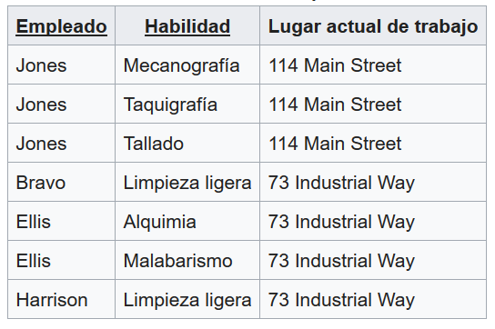
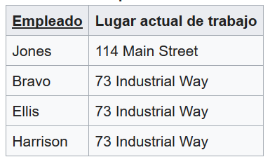
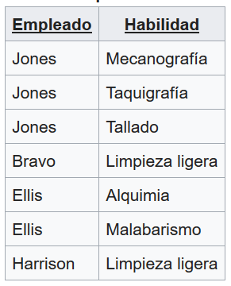
6.2.- Normal Forms
FN2: Examples
In the following example, “Current workplace” has a functional dependency on a part of the key, “Employee, therefore it is not in FN2.
For it to be there, it would have to be transformed into two tables:
9

Slide 10
6.2.- Normal Forms
FN3:
A design is in FN3 if it is in FN2 and, furthermore, there is no attribute that, not being part of the primary key, transitively depends on the primary key. This can be said another way: when there is no attribute that has a dependency on another attribute that is not a primary key.
Representatives
ID | name | surnames | CodProv | Province
11111111B | Anthony | Arias Arias | 39 | Cantabria
12121212C | White | Good good | 28 | Madrid
13131313D | Carlos | Cross Cross | 33 | Asturias
14141414E | Diana | Diaz Diaz | 28 | Madrid
22222222F | Emma | Esquer Esquer | 33 | Asturias
23232323G | frank | Strong Strong | 48 | Bizkaia
24242424H | German | Garcia Garcia | 28 | Madrid
REPRESENTATIVES
ID | name | surnames | CodProv
11111111B | Anthony | Arias Arias | 39
12121212C | White | Good good | 28
13131313D | Carlos | Cross Cross | 33
14141414E | Diana | Diaz Diaz | 28
22222222F | Emma | Esquer Esquer | 33
23232323G | frank | Strong Strong | 48
24242424H | German | Garcia Garcia | 28
PROVINCES
CodProv | ProvName
39 | Cantabria
28 | Madrid
33 | Asturias
48 | Bizkaia
10

Slide 11
6.2.- Normal Forms
FN3:
Difference with FN2: In FN2 we talk about dependency on the key or part of it. In this case we talk about dependence on any attribute.
Another example:
If we have a table of winners of a tournament,
WINNERS ( Tournament, Year, Winner, Date of BirthWinner)
This table is in FN2. Since neither Winner nor WinnerBirthDate functionally depend on Tournament or Year separately, but together.
However, it is not in FN3 since WinnerBirDate functionally depends on Winner.
11

Slide 12
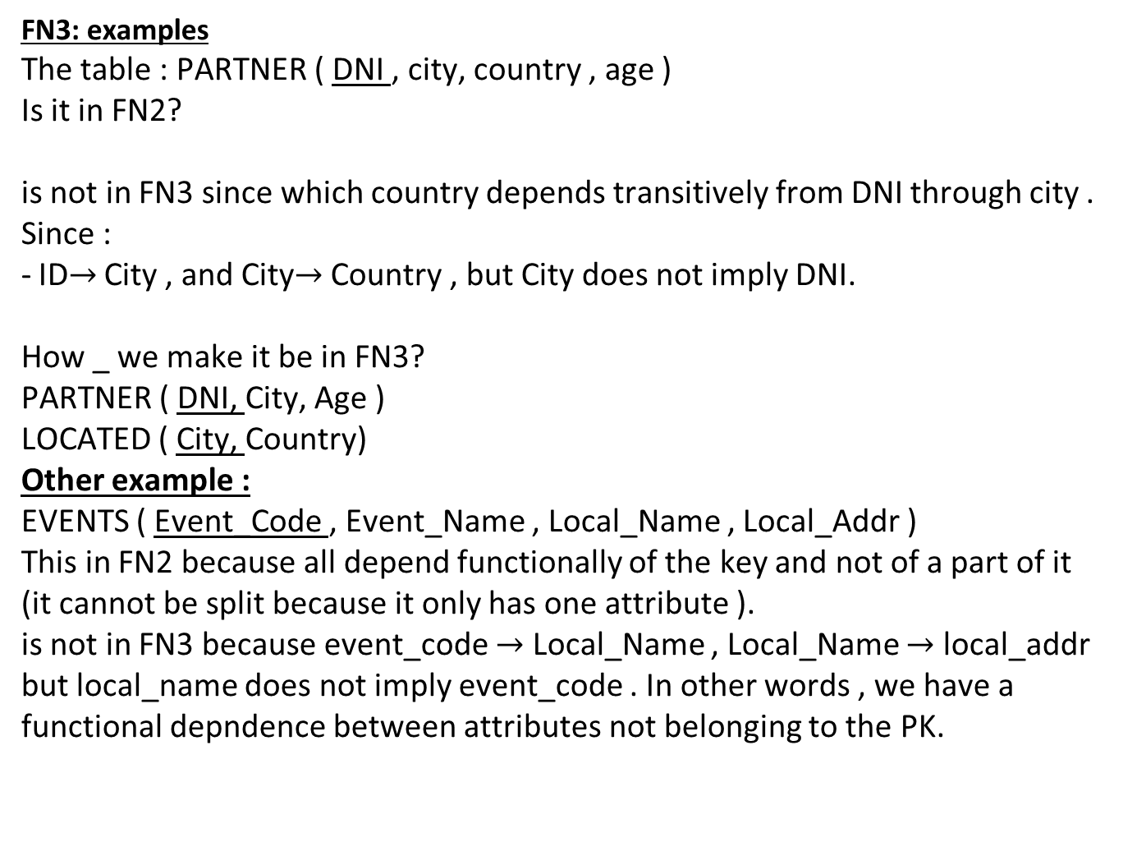
6.2.- Normal Forms
FN3: examples
The table : PARTNER ( DNI , city, country , age )
Is it in FN2?
is not in FN3 since which country depends transitively from DNI through city . Since :
ID$→$ City , and City$→$ Country , but City does not imply DNI.
How _ we make it be in FN3?
PARTNER ( DNI, City, Age )
LOCATED ( City, Country)
Other example :
EVENTS ( Event_Code , Event_Name , Local_Name , Local_Addr )
This in FN2 because all depend functionally of the key and not of a part of it (it cannot be split because it only has one attribute ).
is not in FN3 because event_code $→$ Local_Name , Local_Name $→$ local_addr but local_name does not imply event_code . In other words , we have a functional depndence between attributes not belonging to the PK.
12

Slide 13
6.2.- Normal Forms
Candidate key :
It would be any set of attributes that allow us to identify in a
unique way each element of the entity, and this identification cannot be made with a subset of attributes of the candidate key. For example, within the STUDENT attributes, candidate keys could be:
❑ ID
❑ Registration number
❑ Name + surname + date of birth (considering that name + surname could be repeated and therefore not serve to identify a single element).
However, the set DNI + Registration Number would not be a candidate key because at least a subset of attributes of that candidate key (DNI) allows each element of the entity to be uniquely identified.
Primary or primary key: There can only be one primary or primary key to identify the elements of an entity. The primary key is, among the candidate keys, the one that has the best characteristics to be used as such primary key.
13

Slide 14
6.2.- Normal Forms
Codd Normal Form ):
A design is found on FNBC if it is in FN3 and also all determinant (1) are candidate keys .
In other words , it will not be on FNBC if there is a FD between non- main attributes but not transitive .
(1) In databases , the attribute on which some other attribute functionally depends—completely— is defined as a determinant .
https://esacademic.com/dic.nsf/eswiki/135491#Example
14

Slide 15
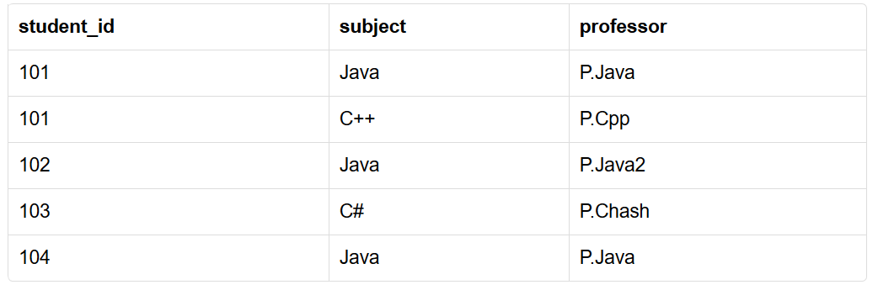
6.2.- Normal Forms
Codd Normal Form ): example
Suppose we have this table :
Which _ would it be the primary key?
FN3 comply ? Yes, because there are no transitive functional depndencies of the primary key.
FNBC comply ? Subject has a functional dependence to professor . Then it doesn't comply .
How do we make it FNBC comply ?
15

